Slide 1
On Transformations
Lecture 3
Jitendra Malik

Slide 2
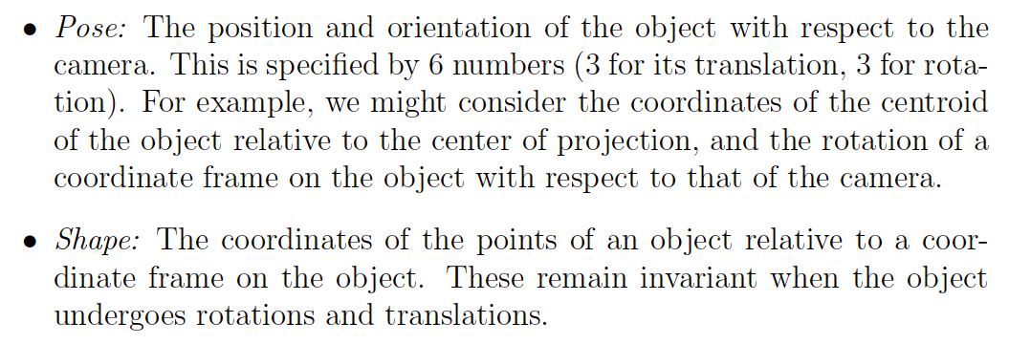
Pose and Shape

Slide 3
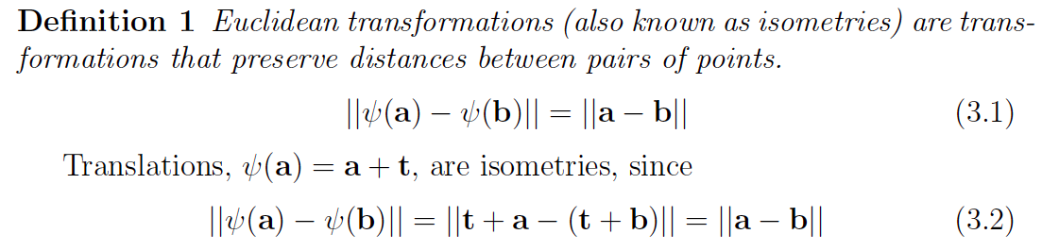

Slide 4
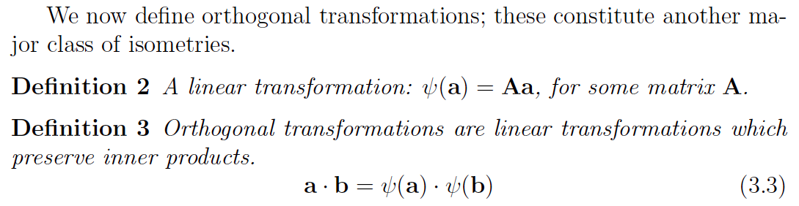
Rotations and reflections are examples
of orthogonal transformations

Slide 5
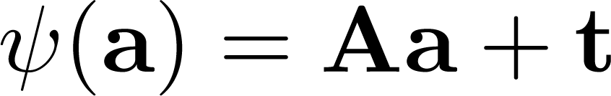

Rigid body motions (Euclidean transformations / isometries)
Theorem: Any rigid body motion can be expressed as an orthogonal transformation followed by a translation.

Slide 6
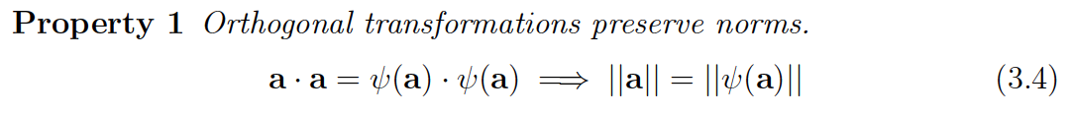

Slide 7
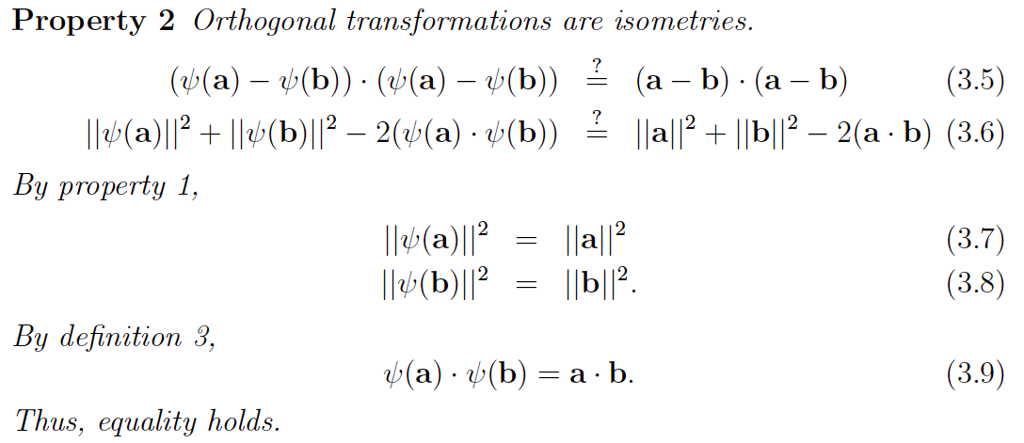

Slide 8
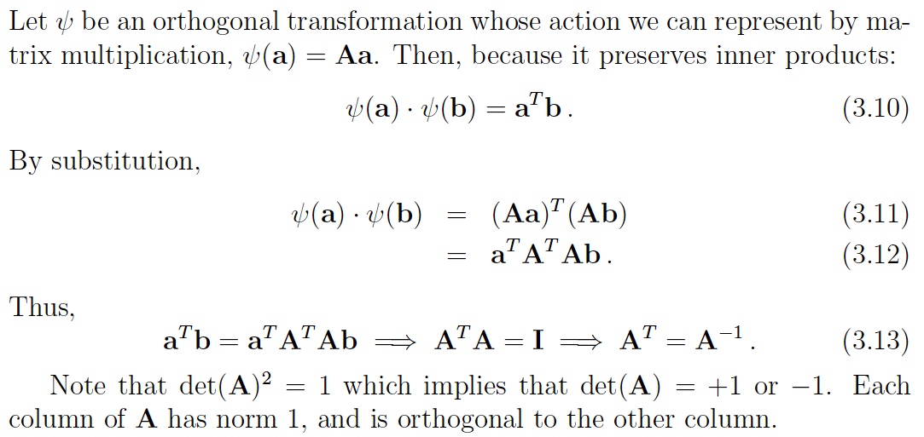
Orthogonal Matrices

Slide 9
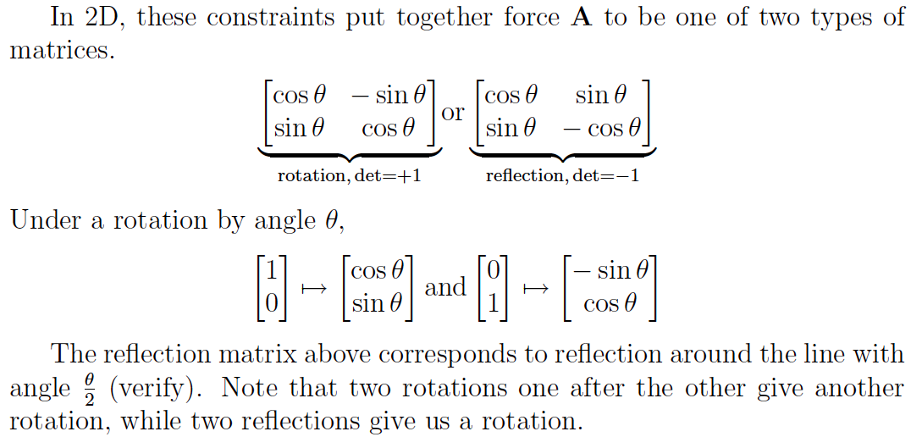
Orthogonal Matrices in 2D

Slide 10
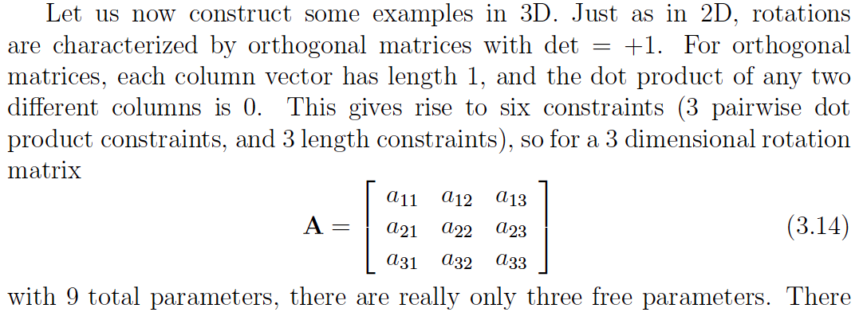
Orthogonal Matrices in 3D

Slide 11

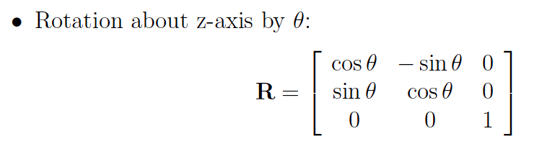
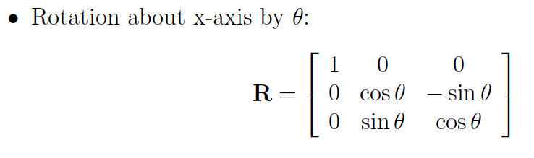

Slide 12
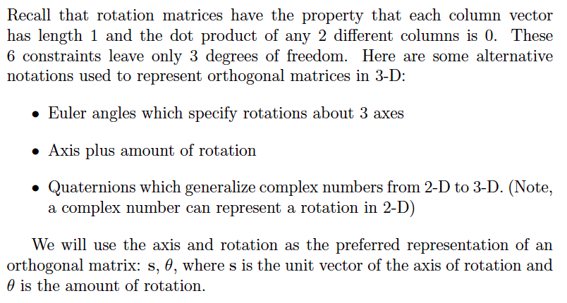
Parameterizing Rotations in 3D

Slide 13
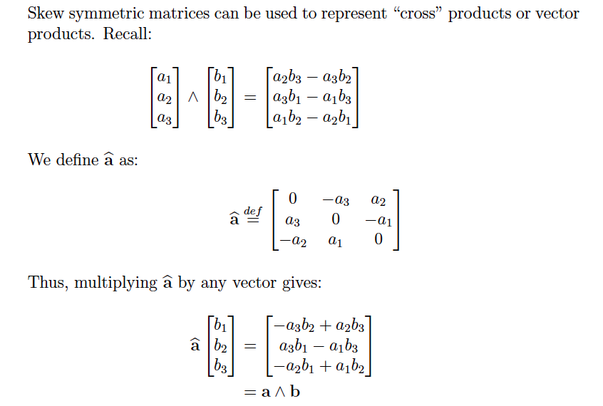

Slide 14
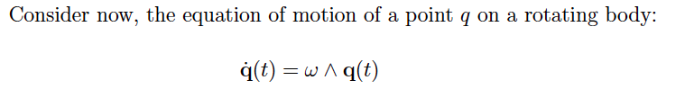
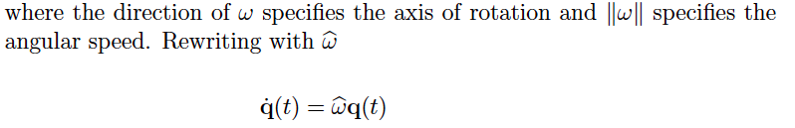

Slide 15
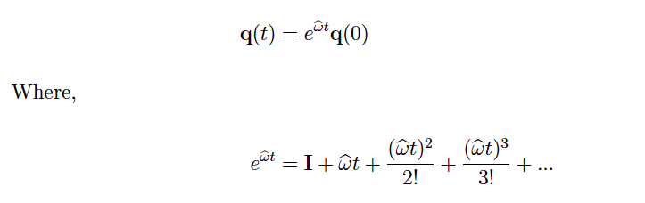
The solution to this differential equation uses the matrix exponential

Slide 16
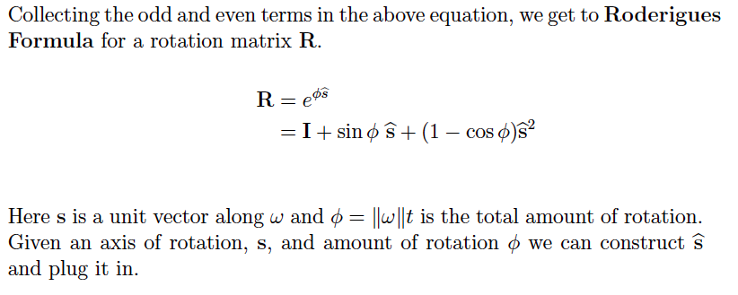

Slide 17
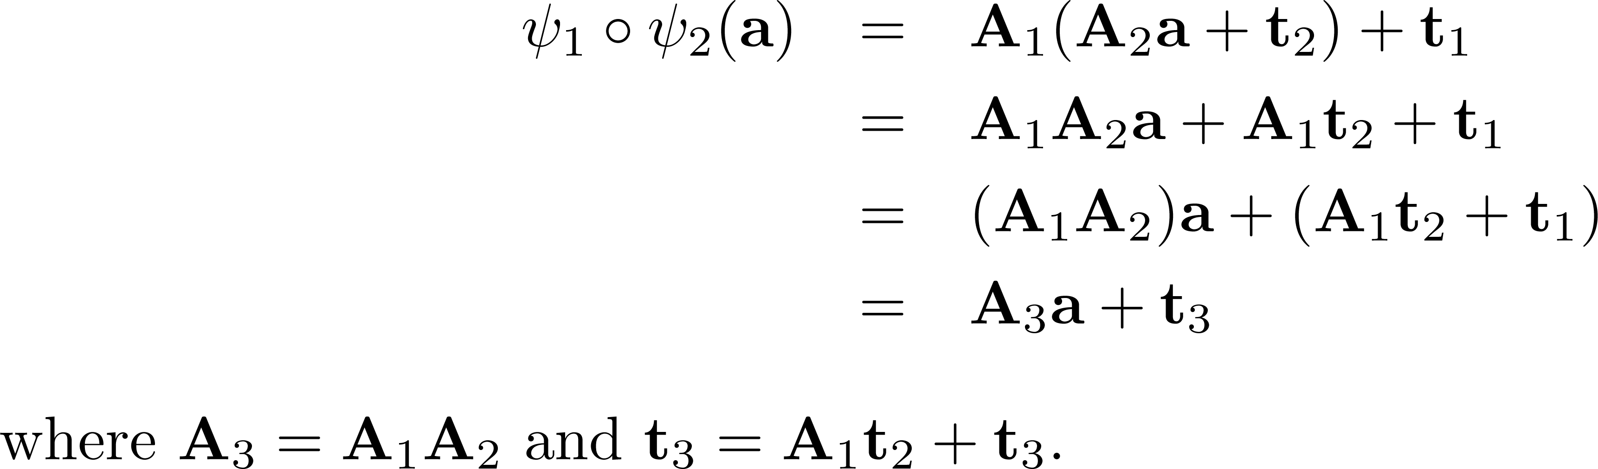

The composition of two isometries is an isometry

Slide 18
Affine transformations
Definition: An affine transformation is a nonsingular linear transformation followed by a translation.

Slide 19
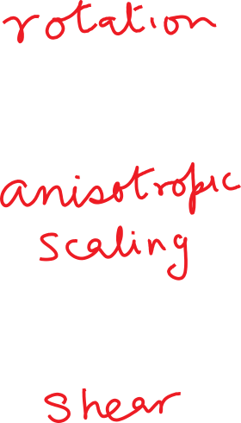
Some examples of affine transforms…

Slide 20
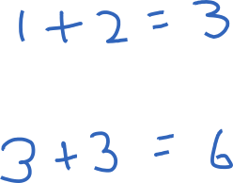
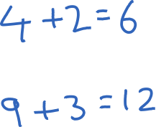
Number of parameters required to specify isometry vs. affine transform
In 2D
In 3D

Slide 21


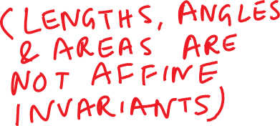
Invariants under transformation (Properties that remain unchanged)
Lengths
Angles
Area
…
Parallelism
Midpoints

Slide 22

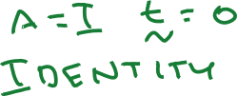




The big picture ...
But are affine transforms as general as we need to be?

Slide 23
Projective Transformations
Under perspective projection, parallel lines can map to lines that intersect. Therefore, this cannot be modeled by an affine transform!
Projective transformations are a more general family which includes affine transforms and perspective projections.
Projective transformations are linear transformations using homogeneous coordinates.
We will study them later in the course.

